Slide 1


Agile in Software Development

Slide 2
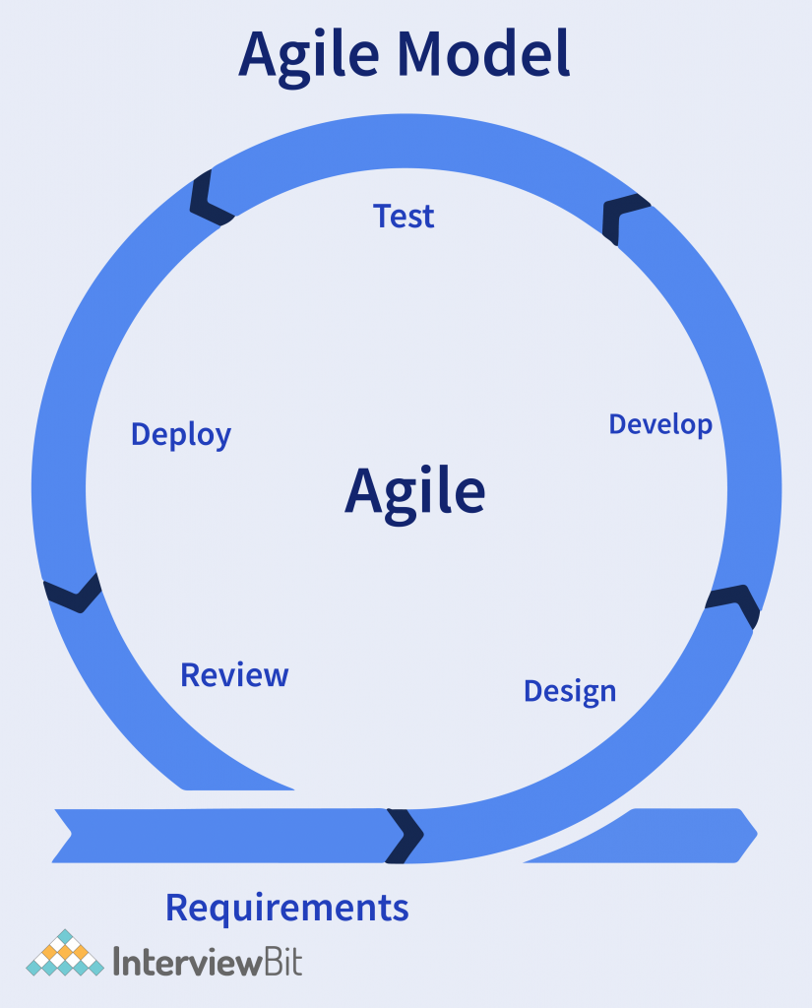
What is Agile ?
A project management approach that involves breaking a project into smaller parts and delivering them in cycles.
Short cycles for immediate feedback and adjustments.
Encourage close collaboration between teams and stakeholders
Focus on delivering value to the customer
Encourage close collaboration between teams and stakeholders.

Slide 3
Values of Agile
Individuals and interactions over processes and tools
Working software over comprehensive documentation
Customer collaboration over contract negotiation
Responding to change over following a plan

Slide 4
Principles of Agile
1. Customer satisfaction through early and continuous delivery
2. Welcome changing requirements
3. Frequent delivery of working software
4. Collaboration between business and developers
5. Motivated individuals
6. Face-to-face communication
7. Working software is the primary measure of progress
8. Sustainable development
9. Continuous attention to technical excellence and good design
10. Simplicity
11. Self-organizing teams
12. Regular reflection and adaptation

Slide 5
Thank You

